Slide 1

What is TEXT ENCODING and Why Should I Care?
Joey Takeda
April 15, 2019
Department of English

Slide 2
Hi!
Joey Takeda, MA Student, Dept. of English Language and Literatures (Science and Technology Studies Program)
Undergrad in English Honours and Gender Studies @ Uvic
Digital Humanities programmer for projects such as The Map of Early Modern London, Linked Early Modern Drama Online, The Winnifred Eaton Archive, and The Endings Project

Slide 3
This Workshop

Slide 4
This Workshop
Brief conceptual introduction to encoding, XML, and TEI

Slide 5
This Workshop
Brief conceptual introduction to encoding, XML, and TEI
Examples of projects that use the TEI

Slide 6
This Workshop
Brief conceptual introduction to encoding, XML, and TEI
Examples of projects that use the TEI
Pointers to further resources on learning about the TEI

Slide 7

Text Encoding and the TEI

Slide 8
Encoding, markup, et cetera…

Slide 9
Encoding, markup, et cetera…
At its core, textual encoding is a way of identifying and differentiating bits of text from other bits of texts.

Slide 10
Encoding, markup, et cetera…
At its core, textual encoding is a way of identifying and differentiating bits of text from other bits of texts.
We do this all the time!

Slide 11
Encoding, markup, et cetera…
At its core, textual encoding is a way of identifying and differentiating bits of text from other bits of texts.
We do this all the time!
Italics for emphasis

Slide 12
Encoding, markup, et cetera…
At its core, textual encoding is a way of identifying and differentiating bits of text from other bits of texts.
We do this all the time!
Italics for emphasis
Underlining for titles

Slide 13
Encoding, markup, et cetera…
At its core, textual encoding is a way of identifying and differentiating bits of text from other bits of texts.
We do this all the time!
Italics for emphasis
Underlining for titles
Bold for extra-emphasis

Slide 14
Encoding, markup, et cetera…
At its core, textual encoding is a way of identifying and differentiating bits of text from other bits of texts.
We do this all the time!
Italics for emphasis
Underlining for titles
Bold for extra-emphasis
Quotation marks for “outside attribution” or “skepticism”

Slide 15
Encoding, markup, et cetera…
At its core, textual encoding is a way of identifying and differentiating bits of text from other bits of texts.
We do this all the time!
Italics for emphasis
Underlining for titles
Bold for extra-emphasis
Quotation marks for “outside attribution” or “skepticism”
All capitals to YELL

Slide 16
Encoding, markup, et cetera…
At its core, textual encoding is a way of identifying and differentiating bits of text from other bits of texts.
We do this all the time!
Italics for emphasis
Underlining for titles
Bold for extra-emphasis
Quotation marks for “outside attribution” or “skepticism”
All capitals to YELL
+++

Slide 17
Encoding, markup, et cetera
But these are contextual and local

Slide 18
Encoding, markup, et cetera
But these are contextual and local
E.g. different types of punctuation for levels of quotation

Slide 19
Encoding, markup, et cetera
But these are contextual and local
E.g. different types of punctuation for levels of quotation
And they are subject to varying interpretations
E.g. I think these quotation marks denote a term, but maybe the author is just being sarcastic…

Slide 20
Why should we encode texts?

Slide 21
Why should we encode texts?
Accessibility

Slide 22
Why should we encode texts?
Accessibility
Distribution

Slide 23
Why should we encode texts?
Accessibility
Distribution
Flexibility

Slide 24
Why should we encode texts?
Accessibility
Distribution
Flexibility
Interoperability

Slide 25
Why should we encode texts?
Accessibility
Distribution
Flexibility
Interoperability
Convertibility (i.e. from one format to another)

Slide 26
Why should we encode texts?
Accessibility
Distribution
Flexibility
Interoperability
Convertibility (i.e. from one format to another)
Analysis (Distant Reading, et cetera)

Slide 27
Why should we encode texts?
Accessibility
Distribution
Flexibility
Interoperability
Convertibility (i.e. from one format to another)
Analysis (Distant Reading, et cetera)
Answering existing (and asking new) research questions

Slide 28
Why should we encode texts?
Accessibility
Distribution
Flexibility
Interoperability
Convertibility (i.e. from one format to another)
Analysis (Distant Reading, et cetera)
Answering existing (and asking new) research questions

Slide 29
The critical stakes of encoding texts
Reinforcing hegemonic/dominant readings of the text
Colonial understanding of the “text” itself
Texts may not want to be “free”--the problems of open access

Slide 30
How do we encode texts?
There are many ways to encode texts:

Slide 31
How do we encode texts?
There are many ways to encode texts:
Using a Word Processor (Microsoft Word, Libre Office, Google Docs, et cetera)

Slide 32
How do we encode texts?
There are many ways to encode texts:
Using a Word Processor (Microsoft Word, Libre Office, Google Docs, et cetera)
Using a WYSWIG (What You See is What You Get) text editor on platforms like Wordpress

Slide 33
How do we encode texts?
There are many ways to encode texts:
Using a Word Processor (Microsoft Word, Libre Office, Google Docs, et cetera)
Using a WYSWIG (What You See is What You Get) text editor on platforms like Wordpress
Using text-based syntaxes like “Markdown” and Wiki formatting

Slide 34
How do we encode texts?
There are many ways to encode texts:
Using a Word Processor (Microsoft Word, Libre Office, Google Docs, et cetera)
Using a WYSWIG (What You See is What You Get) text editor on platforms like Wordpress
Using text-based syntaxes like “Markdown” and Wiki formatting
+++

Slide 35
Activity: Part 1
Handout: John Stow’s Survey of London (1598) (sig. L2r)
16 options
6 colours
CHOOSE 6 of the ITEMS at the bottom and mark each with a DIFFERENT COLOUR

Slide 36
THe next ward towardes the south, is Corn-
hill warde, so called of a corne market, time
out of mind there holden, and is a part of
the principall high streete, beginning at the
west end of Leaden hall, stretching downe
west on both the sides by the south end of
Finckes lane, on the right hand, and by the
North ende of Birchouers lane, on the
left part of which lanes, to wit, to the middle of them is of this
ward and so down to the Stockes market, and this is the bounds
of this Ward. The vpper, or East part of this Warde, and al-
so a part of Lymestreete warde hath beene (as I saide) a
market place, especially for Corne, and since for all kinde
of victuals, as is partly shewed in Limestreete warde, yet it ap-
peareth of record, that in the yere 1522. the Rippars of Rie and
other places solde their fresh fish in Leaden hall market, vpon
Cornhil, but forren Butchers were not admitted, there to sel flesh

Slide 37
ACTIVITY: PART 2
For each of those 6 things you’ve checked off, find those in the document and
DRAW BOXES around each item.
DIRECTION = BLUE PUNCTUATION = RED:
THe next ward towardes the south,

Slide 38
Rules
CORRECT
INCORRECT
Boxes CANNOT OVERLAP
(but their edges can touch)
Boxes CAN nest

Slide 39
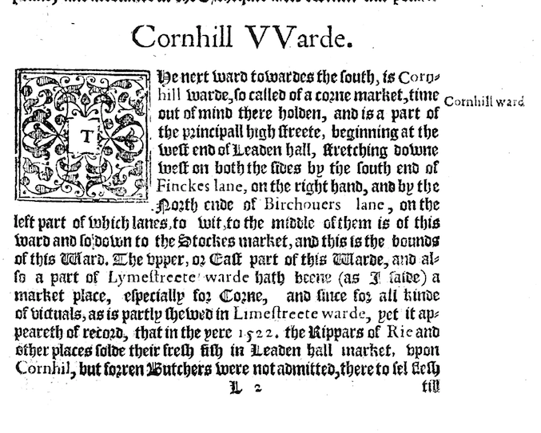
Stow’s Survey of London

Slide 40
Stow’s Survey of London

Slide 41
Stow’s Survey of London

Slide 42
Stow’s Survey of London

Slide 43
Stow’s Survey of London

Slide 44
Stow’s Survey of London

Slide 45
Stow’s Survey of London

Slide 46
XML

Slide 47
XML
XML = eXtensible Markup Language

Slide 48
XML
XML = eXtensible Markup Language
XML is not a set language unto itself, but a grammar

Slide 49
XML
XML = eXtensible Markup Language
XML is not a set language unto itself, but a grammar
XML is hierarchical

Slide 50
XML
XML = eXtensible Markup Language
XML is not a set language unto itself, but a grammar
XML is hierarchical
XML is a tree-like structure

Slide 51
XML
XML = eXtensible Markup Language
XML is not a set language unto itself, but a grammar
XML is hierarchical
XML is a tree-like structure
And is often described in genealogical terms
It is not necessarily a presentational format
Some varieties of XML are (XHTML, SVG, et cetera)

Slide 52
XML
XML = eXtensible Markup Language
XML is not a set language unto itself, but a grammar
XML is hierarchical
XML is a tree-like structure
And is often described in genealogical terms
It is not necessarily a presentational format
Some varieties of XML are (XHTML, SVG, et cetera)

Slide 53
XML is Everywhere
HTML (HyperText Markup Language: Every website)
KML (Keyhole Markup Language: Google Maps)
RDF (Resource Description Framework: Library catalogues)
SVG (Scalable Vector Graphics: Digital Images)
OOXML (Open Office XML: This presentation, word documents, et cetera)

Slide 55
XML
There is nothing inherent about the function of XML

Slide 56
XML
There is nothing inherent about the function of XML
It is purely a structure—a way of organizing

Slide 57
XML
There is nothing inherent about the function of XML
It is purely a structure—a way of organizing
Anyone can conceive of an XML dialect (e.g. it is extensible)

Slide 58
XML
Think of the hierarchy of the book:

Slide 59
XML
Think of the hierarchy of the book:
Book

Slide 60
XML
Think of the hierarchy of the book:
Book
Chapters

Slide 61
XML
Think of the hierarchy of the book:
Book
Chapters
Sections

Slide 62
XML
Think of the hierarchy of the book:
Book
Chapters
Sections
Paragraphs

Slide 63
XML
Think of the hierarchy of the book:
Book
Chapters
Sections
Paragraphs
Sentences

Slide 64
XML
Think of the hierarchy of the book:
Book
Chapters
Sections
Paragraphs
Sentences
Words

Slide 65
XML
Think of the hierarchy of the book:
Book
Chapters
Sections
Paragraphs
Sentences
Words
Letters

Slide 66
XML

Slide 67
XML
<book> <chapter> <section type=“subsection”> <paragraph> <sentence> <word> <letter></letter> </word> </sentence> </paragraph> </section> </chapter> </book>

Slide 68
XML
<book> <chapter> <section type=“subsection”> <paragraph> <sentence> <word> <letter></letter> </word> </sentence> </paragraph> </section> </chapter> </book>

Slide 69
XML
<book> <chapter> <section type=“subsection”> <paragraph> <sentence> <word> <letter></letter> </word> </sentence> </paragraph> </section> </chapter> </book>

Slide 70
XML
<book> <chapter> <section type=“subsection”> <paragraph> <sentence> <word> <letter></letter> </word> </sentence> </paragraph> </section> </chapter> </book>

Slide 71
XML
<book> <chapter> <section type=“subsection”> <paragraph> <sentence> <word> <letter></letter> </word> </sentence> </paragraph> </section> </chapter> </book>

Slide 72
XML
<book> <chapter> <section type=“subsection”> <paragraph> <sentence> <word> <letter></letter> </word> </sentence> </paragraph> </section> </chapter> </book>

Slide 73
XML
<book> <chapter> <section type=“subsection”> <paragraph> <sentence> <word> <letter></letter> </word> </sentence> </paragraph> </section> </chapter> </book>

Slide 74
XML Explained

Slide 75
XML Explained
The two pointy brackets is called an element
E.g. <book> would be called the book element

Slide 76
XML Explained
The two pointy brackets is called an element
E.g. <book> would be called the book element
All elements have start and end tags
E.g. <book> is the start tag and </book> is the end tag

Slide 77
XML Explained
The two pointy brackets is called an element
E.g. <book> would be called the book element
All elements have start and end tags
E.g. <book> is the start tag and </book> is the end tag

Slide 78
XML Explained
The two pointy brackets is called an element
E.g. <book> would be called the book element
All elements have start and end tags
E.g. <book> is the start tag and </book> is the end tag
Elements can also have attributes and each attribute must have a value
E.g. <book type= “primary”> has a type attribute with the value of primary
(Think of attributes as you would in everyday life; people don’t have “height” or “age” without a value)

Slide 79
XML Explained

Slide 80
XML Explained
Elements cannot overlap
<sentence><word>Word1</word></sentence> is right
<sentence><word>Word1</sentence></word> is wrong

Slide 81
XML Explained
Elements cannot overlap
<sentence><word>Word1</word></sentence> is right
<sentence><word>Word1</sentence></word> is wrong
Elements nest and use genealogical terms
I.e this bit of XML
<book>
<chapter></chapter>
</book>
Can be described as “chapter is a child of book” OR “book is a parent of chapter”

Slide 82
XML Explained
Elements cannot overlap
<sentence><word>Word1</word></sentence> is right
<sentence><word>Word1</sentence></word> is wrong
Elements nest and use genealogical terms
I.e this bit of XML
<book>
<chapter></chapter>
</book>
Can be described as “chapter is a child of book” OR “book is a parent of chapter”
There is always a root element
That is, there is always one element that encloses everything

Slide 83
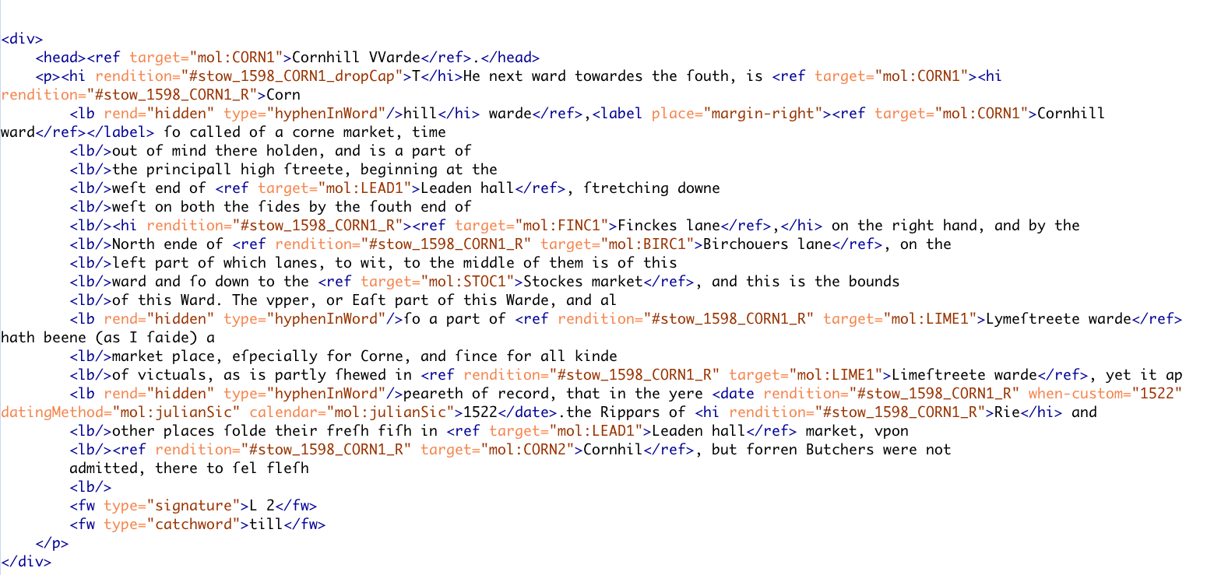

Slide 90
What to encode?
Input ≠ Output
Encode what you care about and what you have time to encode
If you don’t encode it, you can’t do much with it

Slide 91
What to encode?

Slide 92
What to encode?
Input ≠ Output

Slide 93
What to encode?
Input ≠ Output
Encode what you care about and what you have time to encode

Slide 94
What to encode?
Input ≠ Output
Encode what you care about and what you have time to encode
If you don’t encode it, you can’t do much with it

Slide 96
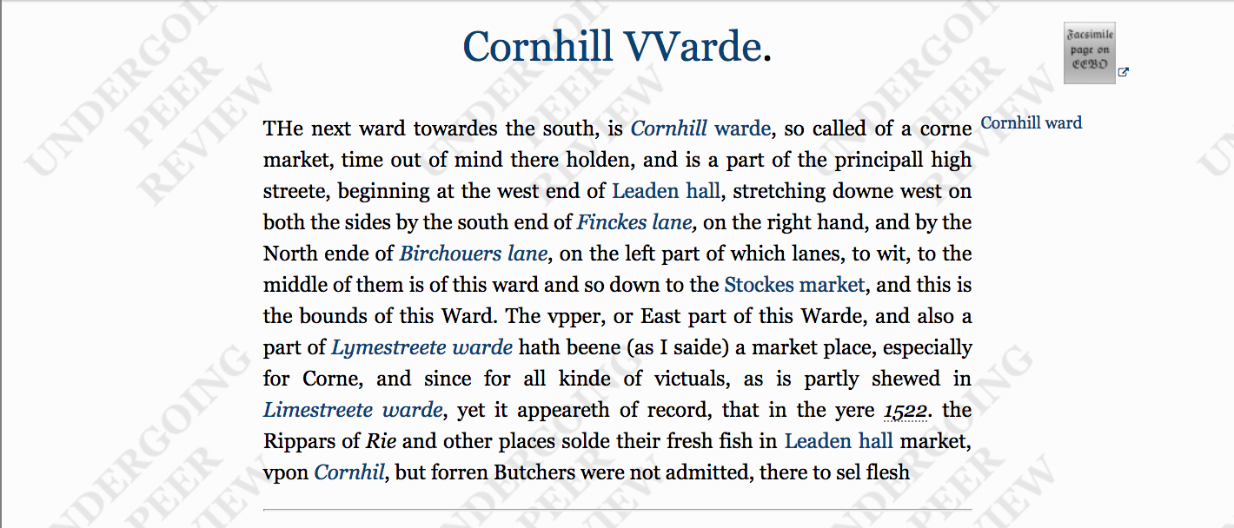

Slide 97
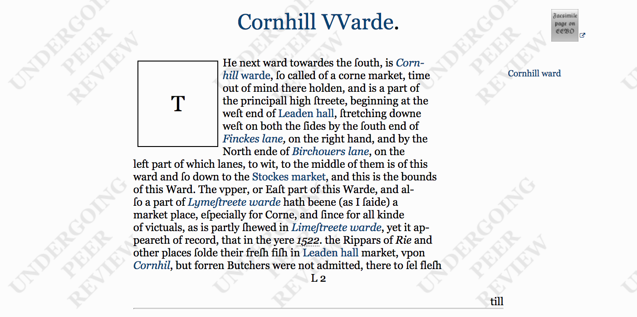

Slide 98
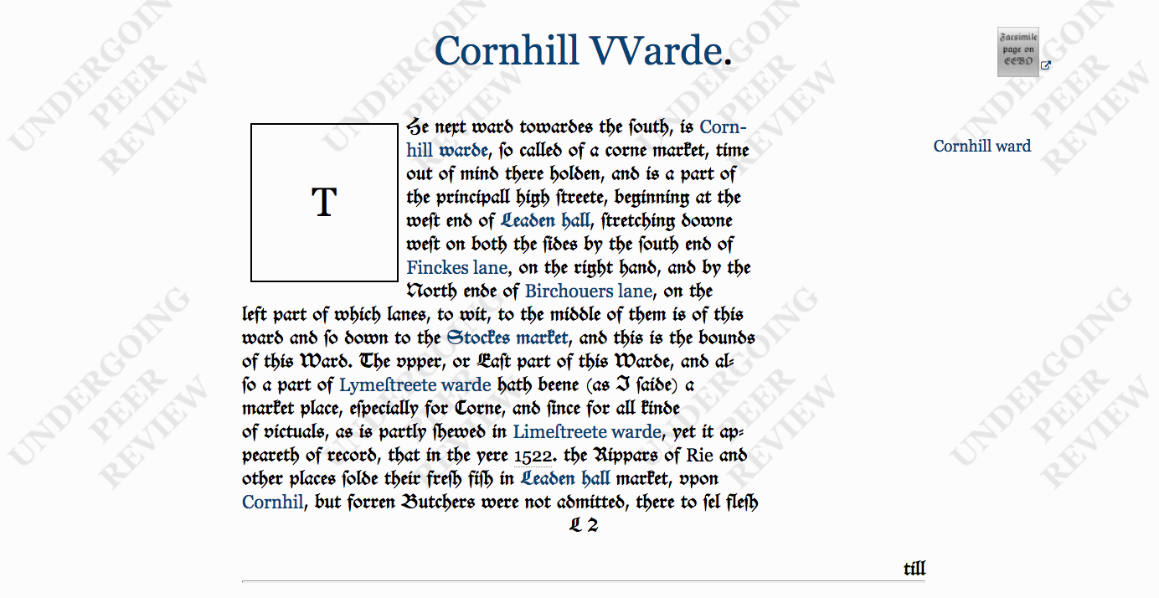

Slide 99
The TEI

Slide 100
The TEI
A set of guidelines for encoding text

Slide 101
The TEI
A set of guidelines for encoding text
A non-profit organization

Slide 102
The TEI
A set of guidelines for encoding text
A non-profit organization
A community or consortium of users

Slide 103
The TEI
A set of guidelines for encoding text
A non-profit organization
A community or consortium of users
Website: https://tei-c.org/

Slide 104
The TEI
Is a markup language written in XML

Slide 105
The TEI
Is a markup language written in XML
Currently in its 5th major revision (P5 3.5.0)

Slide 106
The TEI
Is a markup language written in XML
Currently in its 5th major revision (P5 3.5.0)
Offers a rich vocabulary and method to encode

Slide 107
The TEI
Is a markup language written in XML
Currently in its 5th major revision (P5 3.5.0)
Offers a rich vocabulary and method to encode
Bibliographic and structural features: page breaks, headers, footers, page numbers, line breaks, divisions, paragraphs, line groups, etc

Slide 108
The TEI
Is a markup language written in XML
Currently in its 5th major revision (P5 3.5.0)
Offers a rich vocabulary and method to encode
Bibliographic and structural features: page breaks, headers, footers, page numbers, line breaks, divisions, paragraphs, line groups, etc
Interpretative features: stage movement, emphasis, place names, proper names, dialogue direction, etc

Slide 109
The TEI
Is a markup language written in XML
Currently in its 5th major revision (P5 3.5.0)
Offers a rich vocabulary and method to encode
Bibliographic and structural features: page breaks, headers, footers, page numbers, line breaks, divisions, paragraphs, line groups, etc
Interpretative features: stage movement, emphasis, place names, proper names, dialogue direction, etc
Editorial apparatus: hands, witnesses, collation, gaps, additions, deletions, etc

Slide 110
The TEI
Is a markup language written in XML
Currently in its 5th major revision (P5 3.5.0)
Offers a rich vocabulary and method to encode
Bibliographic and structural features: page breaks, headers, footers, page numbers, line breaks, divisions, paragraphs, line groups, etc
Interpretative features: stage movement, emphasis, place names, proper names, dialogue direction, etc
Editorial apparatus: hands, witnesses, collation, gaps, additions, deletions, etc
Linguistic features: morphemes, feature structures, orthographic form, etc

Slide 111
The TEI
Is a markup language written in XML
Currently in its 5th major revision (P5 3.5.0)
Offers a rich vocabulary and method to encode
Bibliographic and structural features: page breaks, headers, footers, page numbers, line breaks, divisions, paragraphs, line groups, etc
Interpretative features: stage movement, emphasis, place names, proper names, dialogue direction, etc
Editorial apparatus: hands, witnesses, collation, gaps, additions, deletions, etc
Linguistic features: morphemes, feature structures, orthographic form, etc
Spoken features: incidents, pauses, shifts, ”communicative phenomenon”, etc

Slide 112
The TEI
Is a markup language written in XML
Currently in its 5th major revision (P5 3.5.0)
Offers a rich vocabulary and method to encode
Bibliographic and structural features: page breaks, headers, footers, page numbers, line breaks, divisions, paragraphs, line groups, etc
Interpretative features: stage movement, emphasis, place names, proper names, dialogue direction, etc
Editorial apparatus: hands, witnesses, collation, gaps, additions, deletions, etc
Linguistic features: morphemes, feature structures, orthographic form, etc
Spoken features: incidents, pauses, shifts, ”communicative phenomenon”, etc
Metadata: various classification schemes, provenance, manuscript description, etc
+++++

Slide 113
Quick History of the TEI

Slide 114
Quick History of the TEI
The Text Encoding Initiative (originally called the Guidelines for Text Encoding and Interchange)

Slide 115
Quick History of the TEI
The Text Encoding Initiative (originally called the Guidelines for Text Encoding and Interchange)
Started in the late 1980s in response to the boom in “humanities computing”

Slide 116
Quick History of the TEI
The Text Encoding Initiative (originally called the Guidelines for Text Encoding and Interchange)
Started in the late 1980s in response to the boom in “humanities computing”
Wanted to provide a framework and a set of principles for encoding texts that could be widely adopted

Slide 117
Within the noisy market place of the Digital Humanities, the TEI is a kind of senior member, an annoying parental figure for some, a benevolent one for others, something just too old-fashioned even to be considered for others. Yet, over the last decade, it has become increasingly clear that the TEI is part of what makes the digital humanities happen.
(Burnard, “Conclusion”, para. 1)

Slide 118
What the TEI is not

Slide 119
What the TEI is not
The TEI is not a language that describes how a text should be displayed online or in print. It should always concern the performative and expressive significance of the input, not the aesthetics of the output.

Slide 120
What the TEI is not
The TEI is not a language that describes how a text should be displayed online or in print. It should always concern the performative and expressive significance of the input, not the aesthetics of the output.
The TEI is not a programming language; that is, encoding your texts in TEI does not automatically do anything to them

Slide 121
What the TEI is not
The TEI is not a language that describes how a text should be displayed online or in print. It should always concern the performative and expressive significance of the input, not the aesthetics of the output.
The TEI is not a programming language; that is, encoding your texts in TEI does not automatically do anything to them
Caveat: There are many, many tools for transforming TEI into other formats (Word documents, PDFs, and, of course, websites)

Slide 122
The Problem
What colours did your group use for encoding different things?
The same colours as another group?

Slide 123
The Problem
Recall the XML that describes the book from earlier

Slide 124
XML
<book> <chapter> <section type=“subsection”> <paragraph> <sentence> <word> <letter></letter> </word> </sentence> </paragraph> </section> </chapter> </book>

Slide 125
The Problem
How else could it be written?

Slide 126
The Problem
How else could it be written?
<book> <ch> <para> <w> <c></c> </w> </para> </ch> </book>

Slide 127
The TEI Solution

Slide 128
The TEI Solution
All texts must be called <text>

Slide 129
The TEI Solution
All texts must be called <text>
All divisions (whether they be chapters, sections, et cetera) must be called <div>

Slide 130
The TEI Solution
All texts must be called <text>
All divisions (whether they be chapters, sections, et cetera) must be called <div>
All paragraphs must be called <p>

Slide 131
The TEI Solution
All texts must be called <text>
All divisions (whether they be chapters, sections, et cetera) must be called <div>
All paragraphs must be called <p>
All words must be called <w>

Slide 132
The TEI Solution
All texts must be called <text>
All divisions (whether they be chapters, sections, et cetera) must be called <div>
All paragraphs must be called <p>
All words must be called <w>
+++

Slide 133
Components of a (basic) TEI file

Slide 134
Components of a (basic) TEI file
Root <TEI> element

Slide 135
Components of a (basic) TEI file
Root <TEI> element
A <teiHeader> that describes both the file and the primary source that you are transcribing (if applicable)

Slide 136
Components of a (basic) TEI file
Root <TEI> element
A <teiHeader> that describes both the file and the primary source that you are transcribing (if applicable)
A <text> that contains the text of the document
Within text, you can have a <front>, <body>, or <back>

Slide 137
TEI is for Data and Metadata
<TEI>
<teiHeader>
</teiHeader>
<text>
</text>
</TEI>
metadata
data

Slide 138
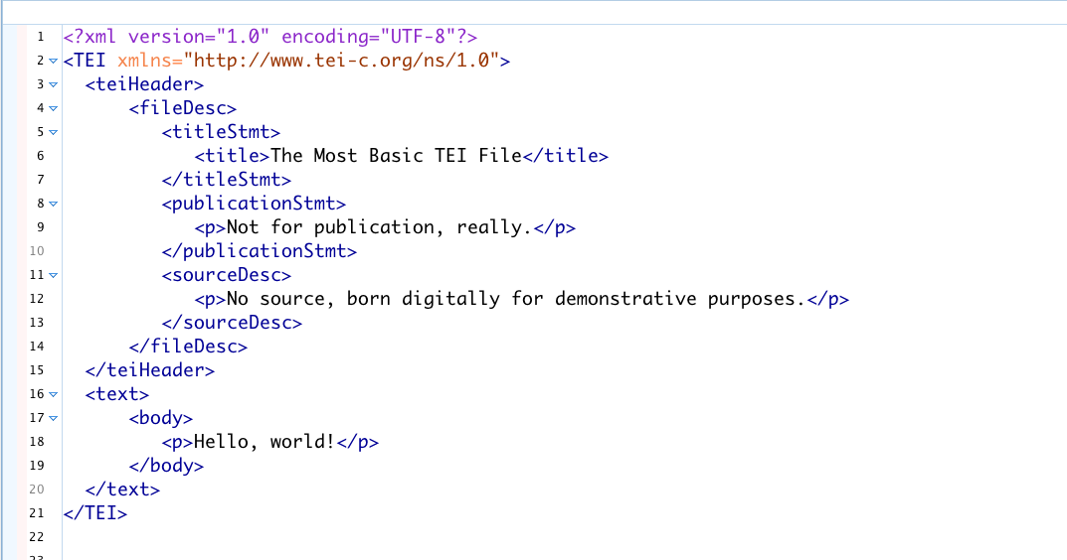
Basic TEI File

Slide 139
TEI

Slide 140
TEI
Note that the TEI is huge (569 elements)

Slide 141
TEI
Note that the TEI is huge (569 elements)
No one uses the entirety of the TEI tagset

Slide 142
TEI
Note that the TEI is huge (569 elements)
No one uses the entirety of the TEI tagset
Individual projects customize the TEI for their own needs, usually using a small subset of the overall tagset

Slide 143
TEI
Note that the TEI is huge (569 elements)
No one uses the entirety of the TEI tagset
Individual projects customize the TEI for their own needs, usually using a small subset of the overall tagset
E.g. Drama projects will use the drama tagset (<sp> for speech, <speaker> for speaker, et cetera) and discard the linguistic/dictionary tagset (<entry> for dictionary entries, <m> for morpheme, etc).

Slide 144
That was A LOT of information in a very short time
Any questions?

Slide 145
Sample TEI Projects

Slide 146
The Winnifred eaton Archive

Slide 147
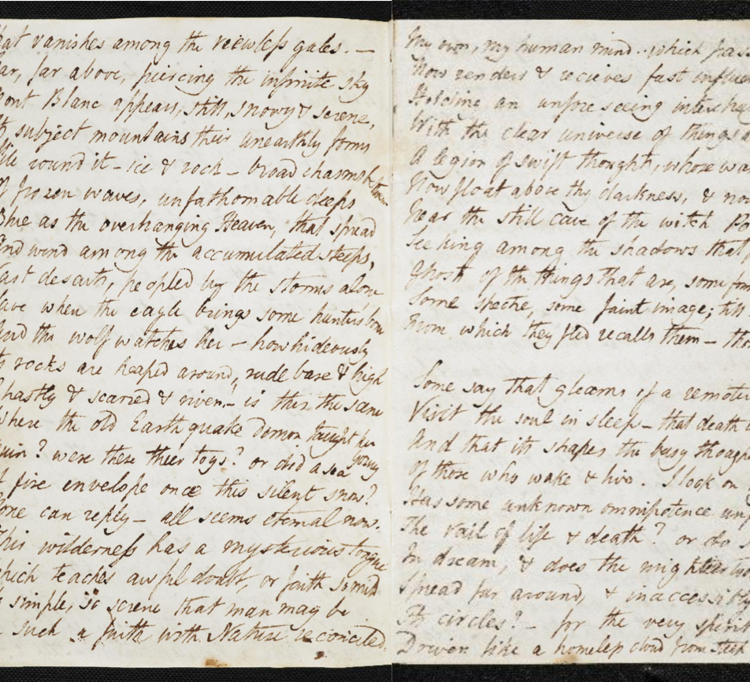
The Shelley-Godwin Archive

Slide 148
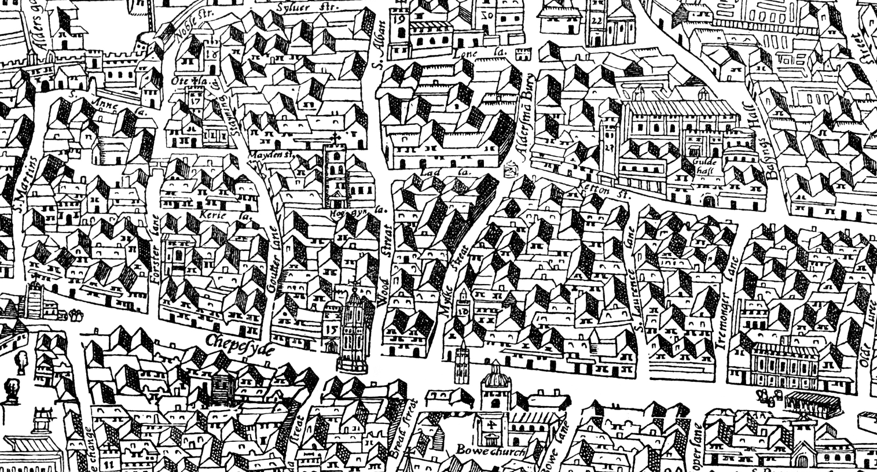
The Map of Early Modern London

Slide 149
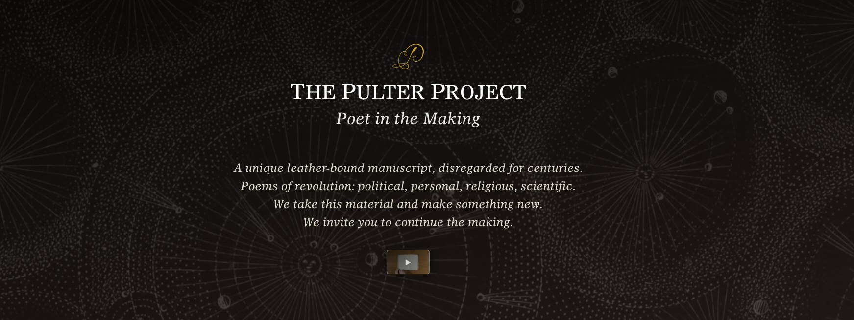
The Pulter project

Slide 150
He Do the Police in Different Voices

Slide 151
Resources
The TEI’s website: https://tei-c.org
TEI by Example: http://teibyexample.org/
Lou Burnard, What is the Text Encoding Initiative?: https://books.openedition.org/oep/679?lang=en
Teach Yourself TEI: http://www.tei-c.org/support/learn/teach-yourself-tei/
DHSI @ UVic: http://www.dhsi.org/courses.php (Scholarships available through DHSI for UBC students)

Slide 152
Further reading
Kirschenbaum, Matthew. “What is Digital Humanities and What’s It Doing in English Departments?” ADE Bulletin, no. 150, 2010.
MacPherson, Tara. “Why are the Digital Humanities So White?” Debates in the Digital Humanities, ed. Matthew K. Gold, University of Minnesota Press, 2015. [Both collections (2012, 2016) are very good]
Johnson, Jessica Marie. “Markup Bodies: Black [Life] Studies and Slavery [Death] Studies at the Digital Crossroads.” Social Text, vol. 36, no. 4, 2018, pp. 57-79.
bianco, jamie skye. “Man and His Tool, Again? Queer and Feminist Notes on Practices in the Digital Humanities and Object Orientations Everywhere.” Digital Humanities Quarterly, 2015. [This is an interactive article: http://www.spikenlilli.com/projects/dhq/queerfemnotes.html]

Slide 153
Thanks!
Department of English Language and Literatures
Martin Holmes, Janelle Jenstad, The Endings Project, Uvic’s Humanities Media and Computing Center, and Mary Chapman.

